Slide 1
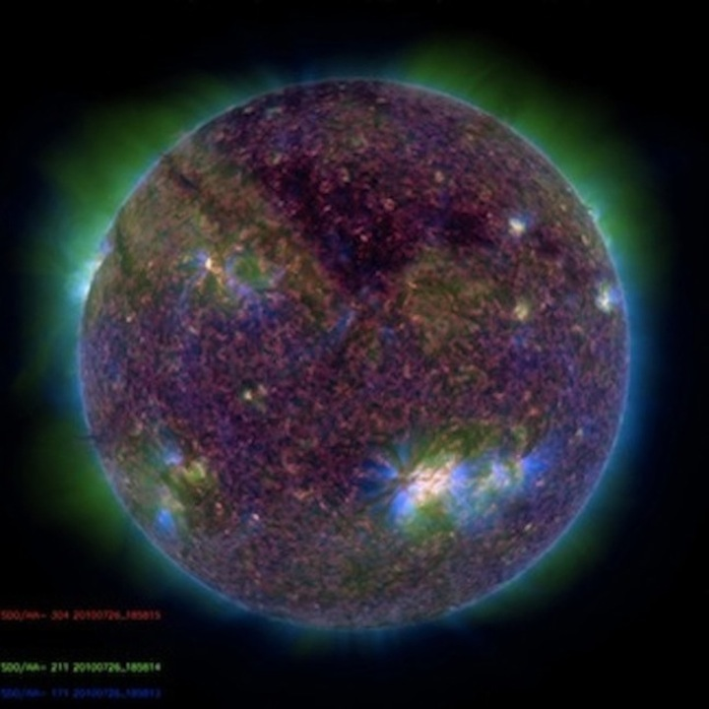
POLAR CORONAL HOLES
A Link to Predicting Solar Maximum
Shea A. Hess Webber
W. Dean Pesnell
Summer 2010

Slide 2
Perimeter Tracking Method
SOHO EIT images, 3 wavelengths
Picking boundary points along limb
Limb brightening
Thresholding
Tracking points over Harvey Rotation
Differential rotation
Approximately 27 days at equator (Carrington Rotation)
Approximately 33 days at the poles (Harvey Rotation)
Trig fit to resolve areas with uncertainties

Slide 3
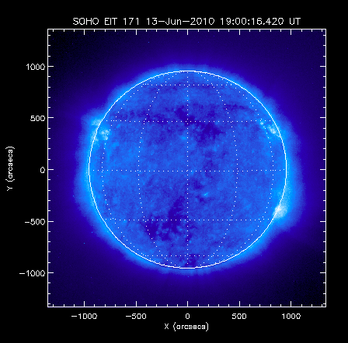
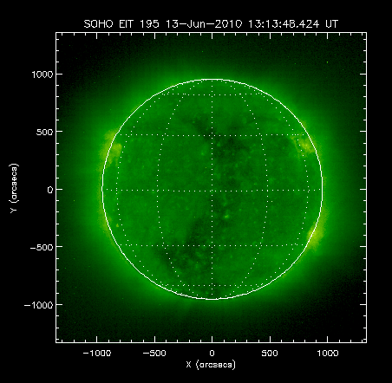
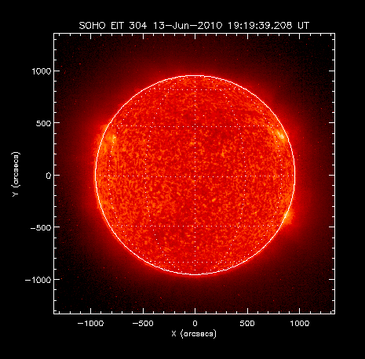
304 Å (He II) in red
171 Å (Fe XI/X) in blue
195 Å (Fe XII) in green
Scale Height:
H = kT/Mg
k = Boltzmann constant
T = Temperature (in K)
M = mean molecular mass of particles
g = acceleration of gravity
Different ions at varying temperatures equate to different heights in the solar atmosphere.
304 Å → upper chromosphere
171 Å and 195 Å → corona

Slide 4
Perimeter Tracking Method
SOHO EIT images, 3 wavelengths
Picking boundary points along limb
Limb brightening
Thresholding
Tracking points over Harvey Rotation
Differential rotation
Approximately 27 days at equator (Carrington Rotation)
Approximately 33 days at the poles (Harvey Rotation)
Trig fit to resolve areas with uncertainties

Slide 5
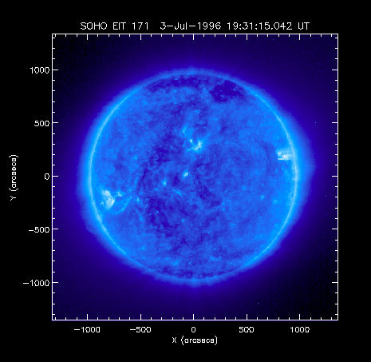
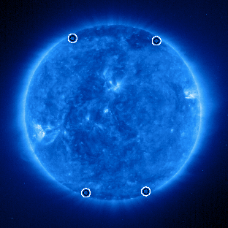
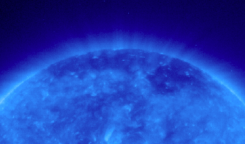

Slide 6
Perimeter Tracking Method
SOHO EIT images, 3 wavelengths
Picking boundary points along limb
Limb brightening
Thresholding
Tracking points over Harvey Rotation
Differential rotation
Approximately 27 days at equator (Carrington Rotation)
Approximately 33 days at the poles (Harvey Rotation)
Trig fit to resolve areas with uncertainties

Slide 7
Perimeter Tracking Method
SOHO EIT images, 3 wavelengths
Picking boundary points along limb
Limb brightening
Thresholding
Tracking points over Harvey Rotation
Differential rotation
Approximately 27 days at equator (Carrington Rotation)
Approximately 33 days at the poles (Harvey Rotation)
Trig fit to resolve areas with uncertainties

Slide 8
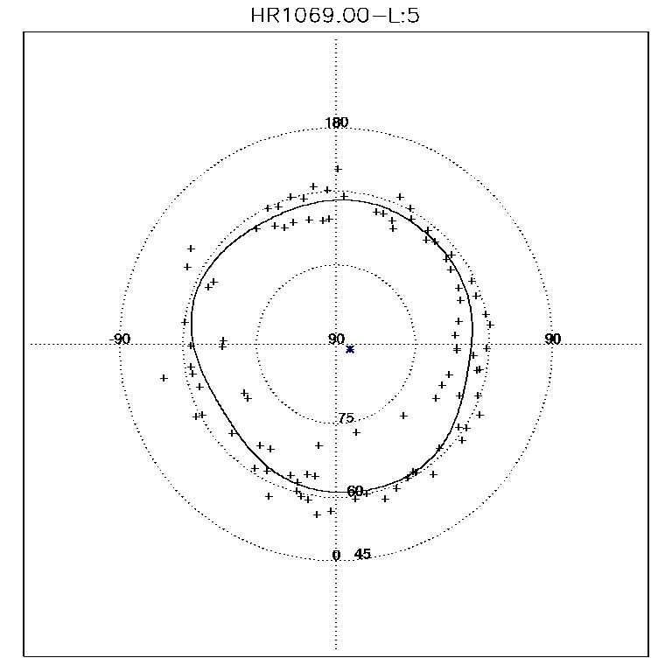
Southern Polar Coronal Hole Average

Slide 9
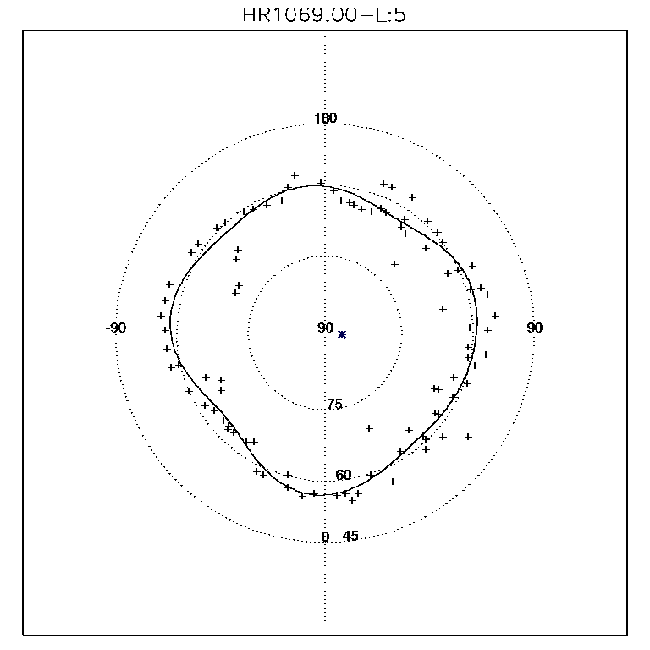
Northern Polar Coronal Hole Average

Slide 10
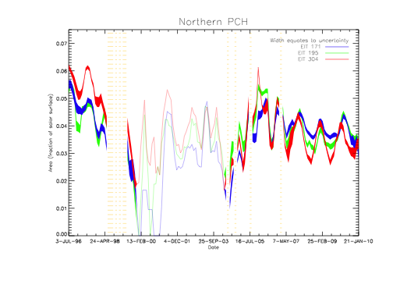

Slide 11
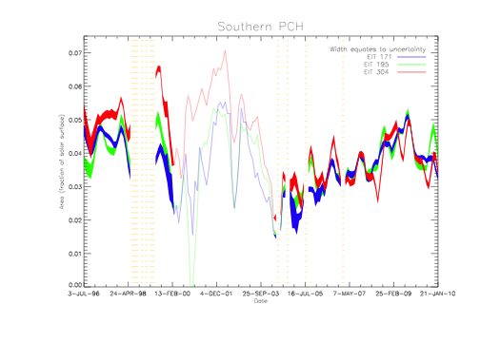

Slide 12
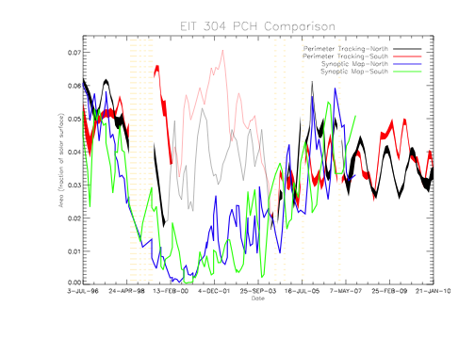
Updated Data
Threshold adjustment in all wavelengths
Extended data time series from 2007 to 2010
304 Å comparison with Nishu

Slide 13
Further Work
Fine-tune thresholds
Adjust programs to run by HR vs. by year
Convert programs to work with SDO data
Do similar image analysis with magnetograms and compare
Re-address solar B angle periodicity

Slide 14
Acknowledgments
W. Dean Pesnell
Nishu Karna
Peter Williams
Mike Kirk
Alex Young
Most of the Solar Physics scientists…
Background Image: SDO AIA Composite Image
Data Images: SOHO EIT Images

Slide 15
